Slide 1
Amphibian Presence Prediction
Jerry Ngo

Slide 2
Intro
Based on satellite information on amphibian appearance, give prediction on the occurrence of amphibian based on the site’s attribute.
Applying model like decision tree, support vector machine, artificial neural network on the data set.

Slide 3
Data Set

Slide 4
Data Set Information
Was prepared for the environmental impact assessment reports for two planned road in Poland.
Gives the amphibian population with 189 occurence sites along with 16 attributes of each site.
7 amphibian species

Slide 5
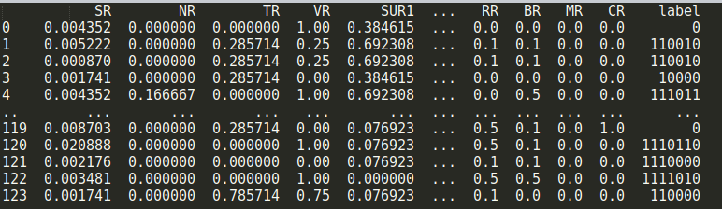
Data Set Preprocess
Data is well collected and presented
Apply min-max normalization
Select attribute for training
Concatenate label
Split training and validation set

Slide 6
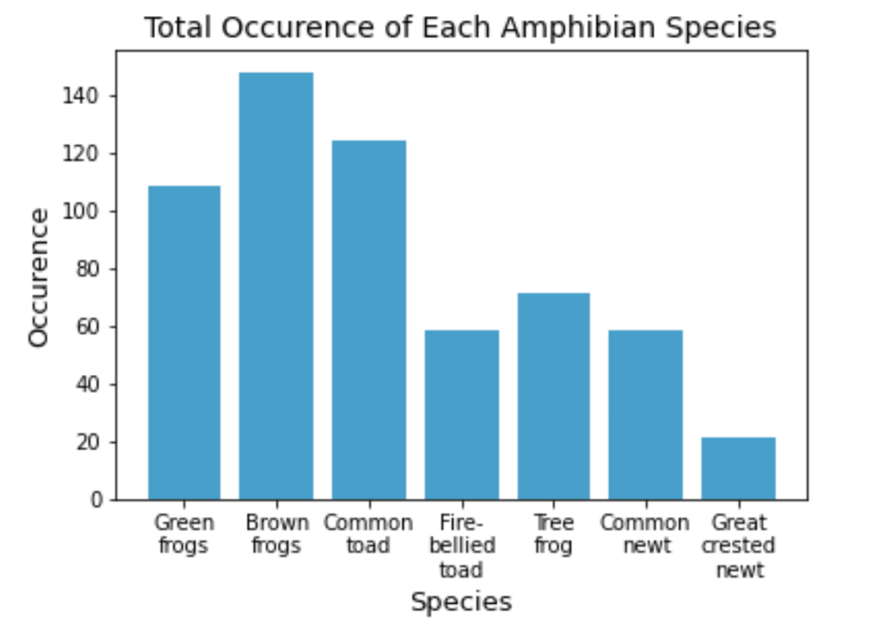
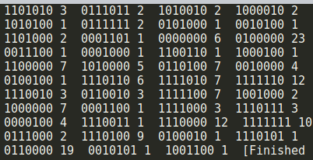
Data Set Analyzation
Distribution is not evenly distributed

Slide 7
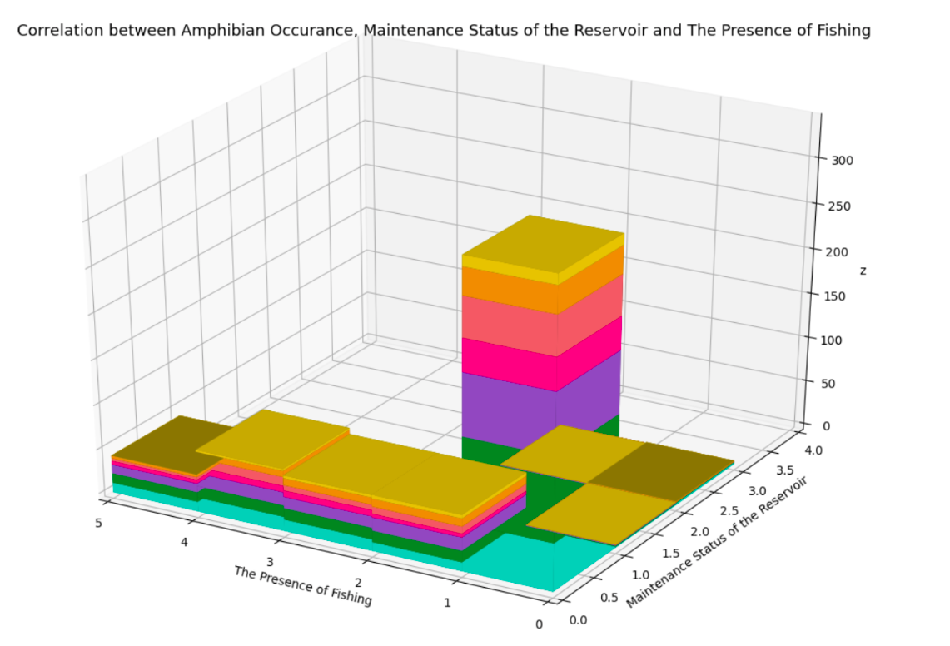
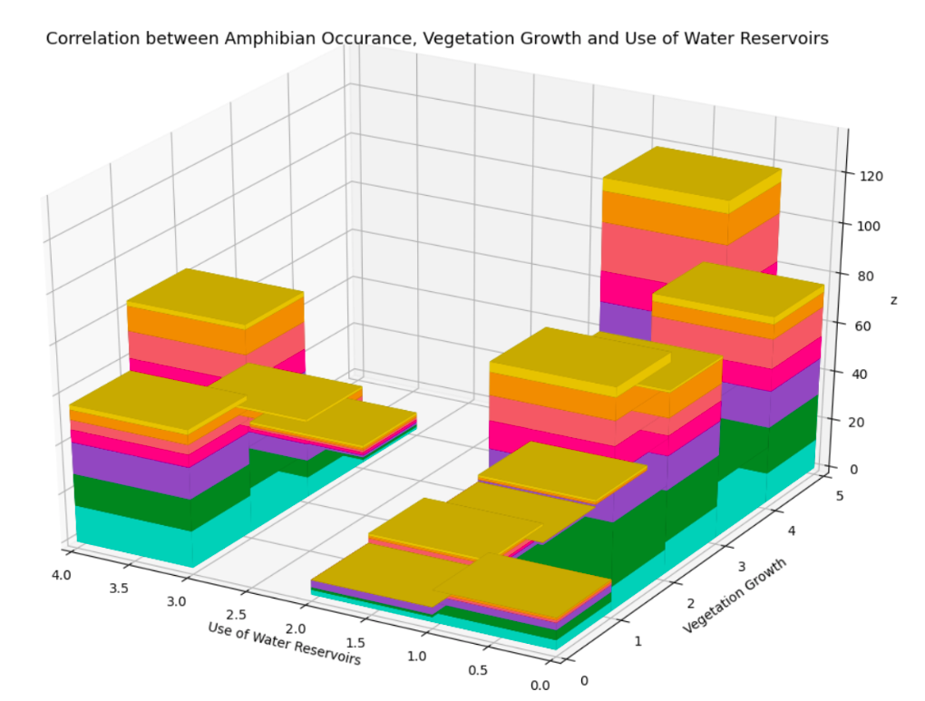
Data Set Analyzation
No attributes that can be used to easily predict the species occurrence

Slide 8
Machine Learning Model

Slide 9
Flawed Models

Slide 10
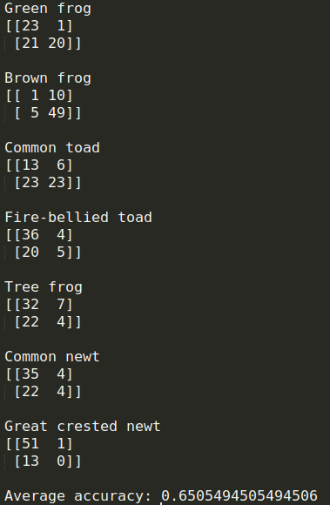
Support Vector Machine
True Negative | False Positive
False Negative | True Positive
Radial Basis Function kernel with the degree of 3
Accuracy of binary label data set: 65% with validation set | 67.7% with LOOCV
Accuracy of constructing 7 SVMs corresponding with each species: 65.27%

Slide 11
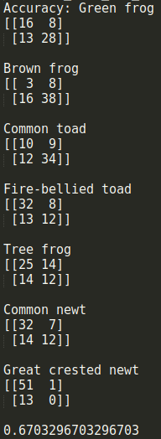
Artificial Neural Network
20 hidden layers with the size of 9
RELU for activation
Limited-memory BFGS solver for weight optimization
Accuracy: 67% with validation set | 64% with LOOCV

Slide 12
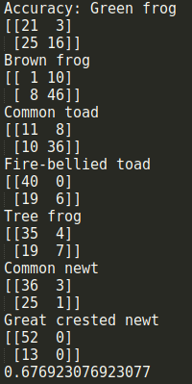
Decision Tree
Use gini for split criteria
Max depth of 4
Accuracy: 68.1% with validation set | 65.1% with LOOCV

Slide 13
Updated Models

Slide 14
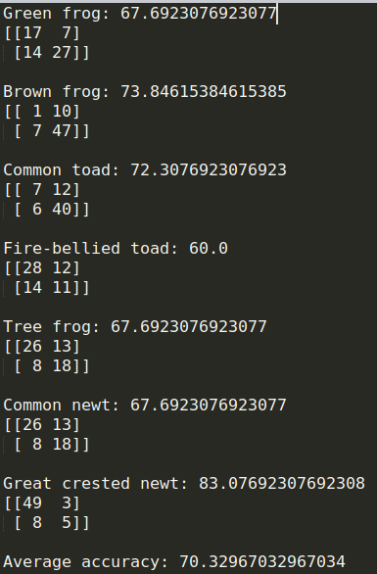
Support Vector Machine
True Negative | False Positive
False Negative | True Positive
Tune the punishment of soft margin, kernel (poly, RBF), the degree of the poly kernel and balanced the class weight for imbalance species of each SVM
Accuracy of binary label data set: 70.33%

Slide 15
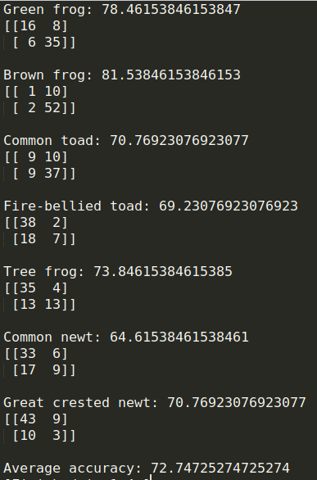
Artificial Neural Network
Tune the number and the size of hidden layer for each ANN
lbfgs for activation
Limited-memory BFGS solver for weight optimization
Accuracy: 72.75%

Slide 16
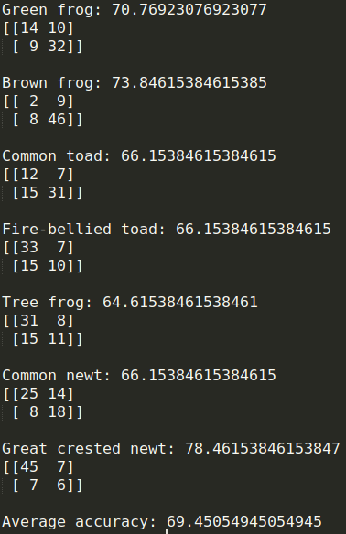
Decision Tree
Tune splitting criteria, maximum tree depth, number of features to consider when looking for the best split and whether it uses should balance the class weight for each Decision Tree
Accuracy: 69.45%

Slide 17
Ensemble Models

Slide 18
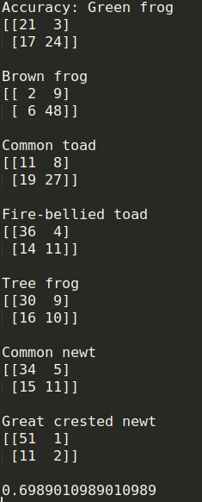
Random Forest
Set the max depth of 4
Learning rate: 0.72
Random state of 6
Accuracy: 69.9%

Slide 19
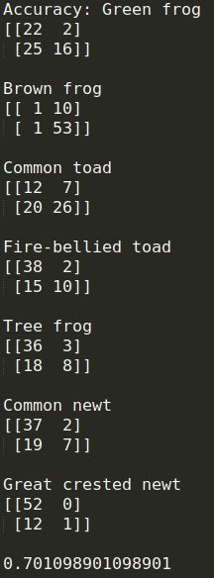
AdaBoost
Use the previous decision tree classifier for the base classifier
Learning rate: 0.72
Random state of 5
Accuracy: 70.1% with validation set

Slide 20
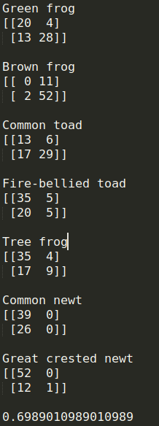
Stacking using Bayes Optimal Classifier
Use 6-Fold to choose the best training set to train the Bayes classifer using the base learners (SVM, Decision Tree, ANN)
Use Gaussian Naive Bayes classifier as meta classifier
Accuracy: 69.9%

Slide 21
Classifier | Accuracy
SVM | 70.33%
KNN | 64.6%
ANN | 72.75%
Decision Tree | 69.45%
Random Forest | 69.9%
Bayes Stacking | 69.9%
AdaBoost | 70.1%
Overall ANN based on the decision tree has the best performance of 72.75%
Because of the uneven distribution and a really small instance, it is hard to get a better accuracy

Slide 22

Thanks!
Phuc Ngo, Beloit College
ngoph@beloit.com

